Slide 1


Wind Turbine Electricity Prediction

Slide 2
Dataset
Initially the dataset consist of 50k points
Reduced to 5k
Features:
Date/Time
LV ActivePower (kW),
Wind Speed (m/s),
Theoretical_Power_Curve (KWh)
Wind Direction (°)
End date: 09 02 2018 05:00
Start date: 01 01 2018 00:00

Slide 3
Applications
Business Perspective: Calculate the rate at which the customers should be charged
Environmental Perspective: If enough electricity can be generated from wind turbines, we can eliminate use of fossil fuels

Slide 4

Stationary data
Test for stationarity:
ADF Statistic: -3.994378
p-value: 0.001440
Critical Values:
1%: -3.432
5%: -2.862
10%: -2.567

Slide 5
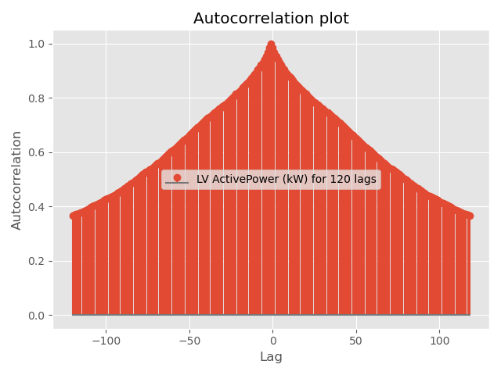
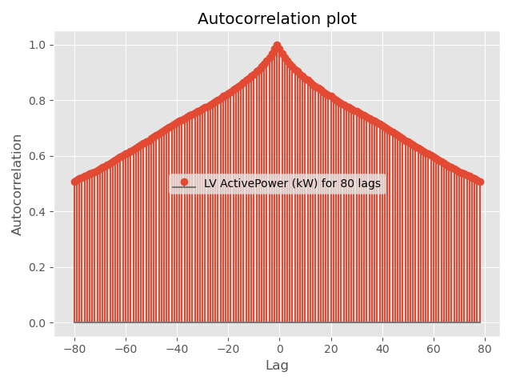
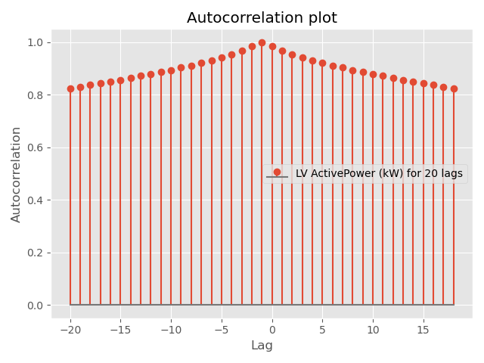
ACF of Dependent Variable

Slide 6
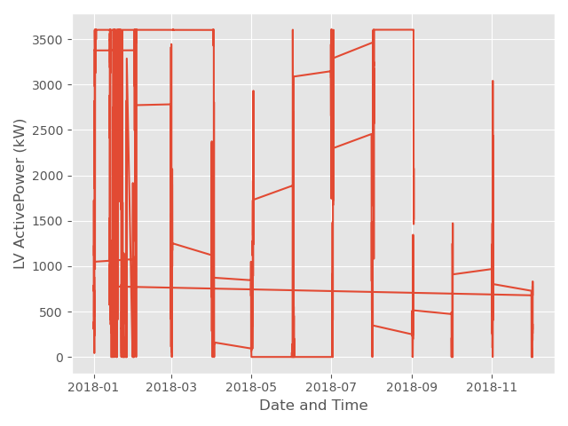
Dependent VS Time

Slide 7
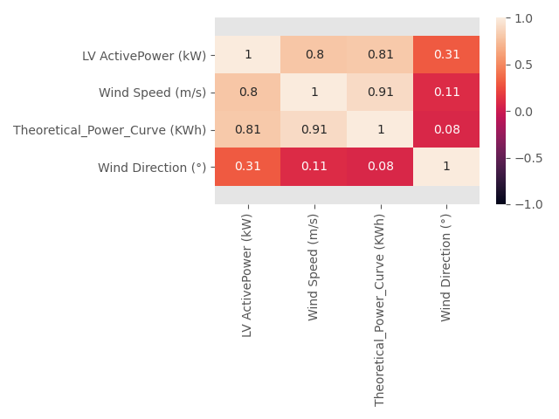
Correlation Coefficient:
Person's Correlation Coeff:
LV ActivePower-Wind Speed: 0.8010269972589192
LV ActivePower-Theoretical_Power_Curve: 0.8144311570359695
LV ActivePower-Wind Direction: 0.3115103700278061

Slide 8
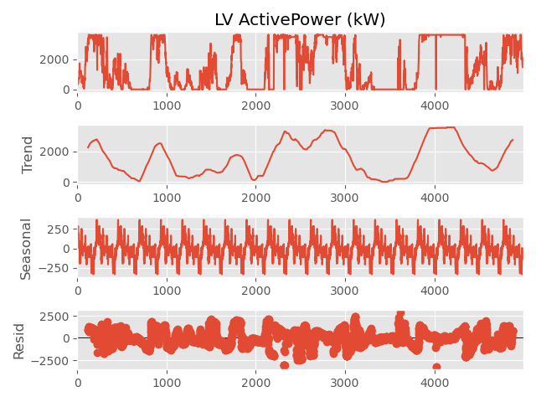
Time Series Decomposition

Slide 9
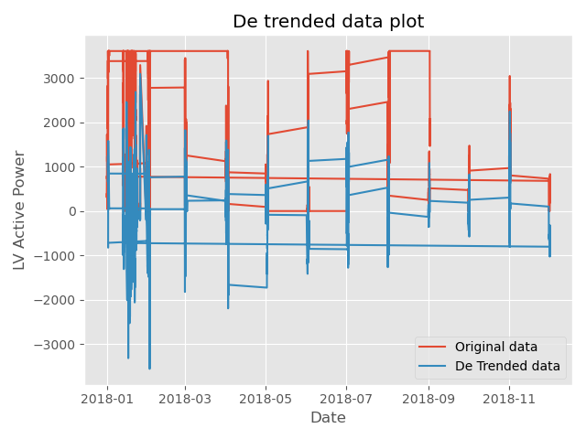
De Trended data: The strength of trend for data set is: 0.7042208166148513
The strength of seasonality for data set is: 0.025644565545394293

Slide 10
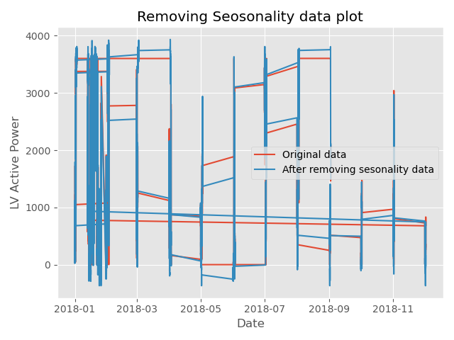
Removing Seasonality: The strength of trend for data set is: 0.7042208166148513
The strength of seasonality for data set is: 0.025644565545394293

Slide 11
Feature Selection
Features​ | AIC​ | BIC​ | P value​ | Adj R2​
Wind Speed , Theoretical_Power_Curve, Wind Direction | 80454.51336522578​ | 80480.58213799144​ | 0.0​ | 0.7388687674669445​
Wind Speed, Theoretical_Power_Curve | 81414.7533410593​ | 81434.30492063356​ | 0.0​ | 0.6835165521748432​
Wind Speed | 81414.7533410593​ | 81434.30492063356​ | 0.0​ | 0.6835165521748432​
Final values selected were Wind speed and Wind direction

Slide 12
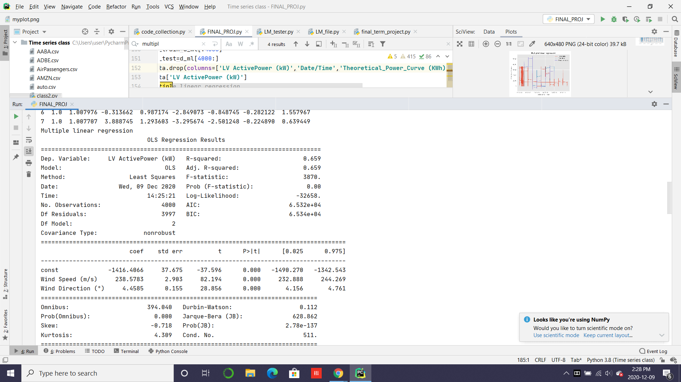
Multiple Linear Regression

Slide 13
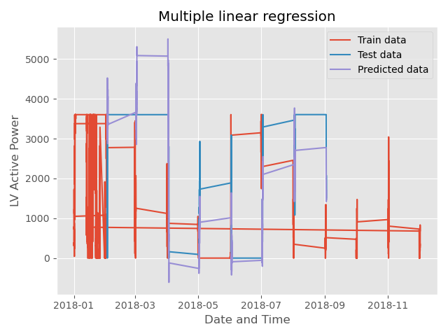
Multiple Linear Regression Forecast

Slide 14
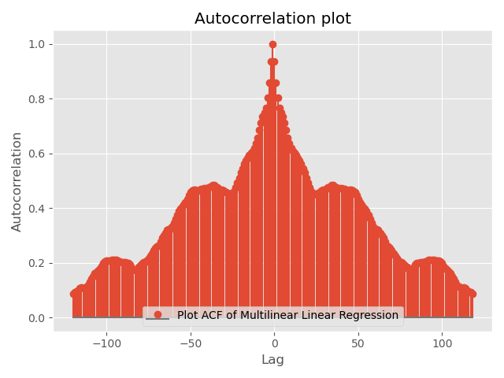
Multiple-Linear Regression Accuracy
Adj R2 0.659266273005014
AIC 65321.85974934304
BIC 65340.741898263346
F statistic 3869.718616437177
F p-value 0.0
Q value 40.16520043050357
Mean of residue 177.6439324653744
Variance of residue 457702.62080746226

Slide 15

Base Models

Slide 16
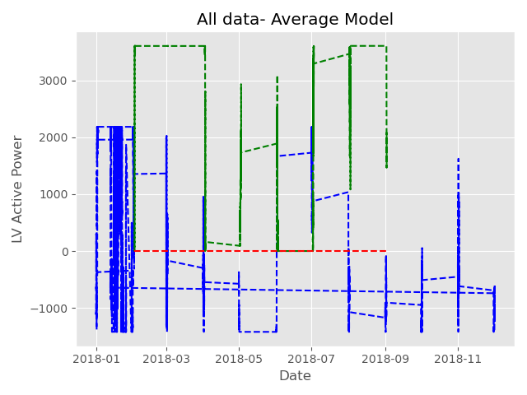
Average Model:
Mean of error of Average Model 105.49108012674635
Variance of error of Average Model 1941719.830479737
MSE of Average Base Model 1952848.1984660444
RMSE of Average Base Model 1397.4434509009816

Slide 17
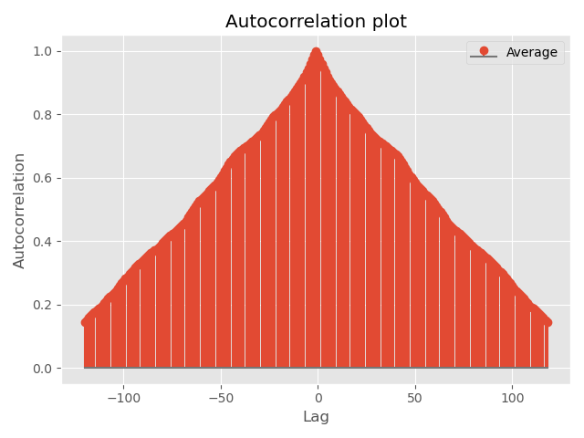
ACF of Average Model

Slide 18
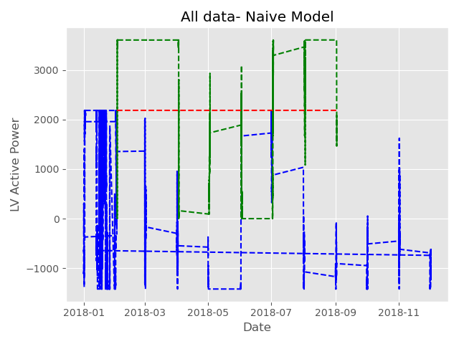
Naïve Model
Mean of error of Naïve Base Model 94.30954345504651
Variance of error of Naïve Base Model 1822037.7141250235
MSE of Naïve Base Model 1830932.0041117226
RMSE of Naïve Base Model 1353.1193606299935

Slide 19
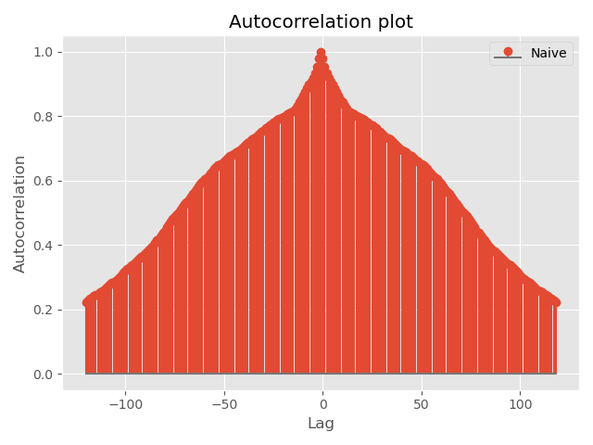
ACF of Naïve Model

Slide 20
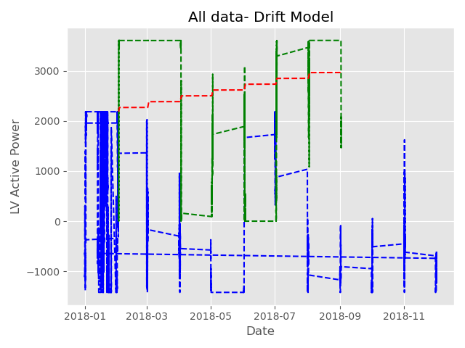
Drift Model
Mean of error of Drift Base Model
-2478.7502767393594
Variance of error of Drift Base Model 2010314.4396619329
MSE of Drift Base Model 8154517.3740973845
RMSE of Drift Base Model
2855.6115586853516

Slide 21
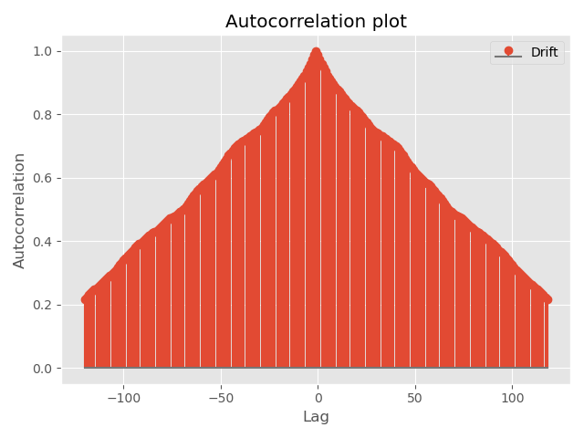
ACF of Drift Model

Slide 22

SES Model
Mean of error of SES Model
-2478.7502767393594
Variance of error of SES Model 2010314.4396619329
MSE of SES Model 8154517.3740973845
RMSE of SES Model 2855.6115586853516

Slide 23

ACF of SES Model

Slide 24
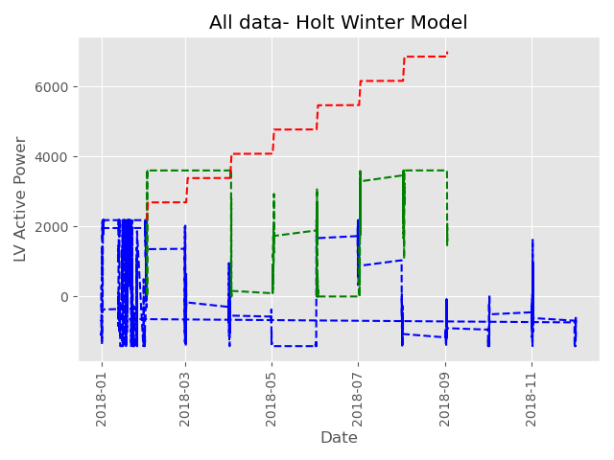
Holt Winter Model
Mean of error of Holt Winter Model -2319.5252833418326
Variance of error of Holt Winter Model 5145833.725079206
MSE of Holt Winter Model 10526031.265141152
RMSE of Holt Winter Model 3244.384574174454

Slide 25
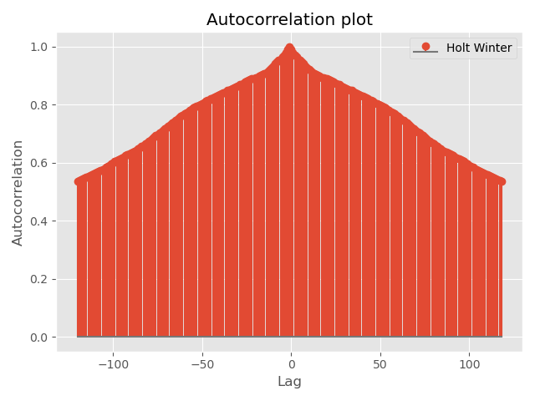
ACF of Holt Winter Model

Slide 26
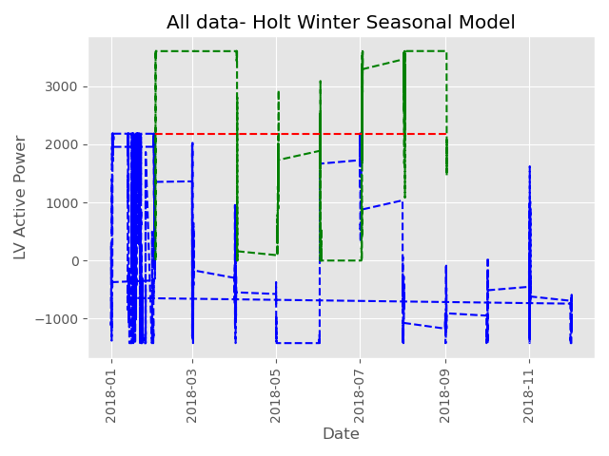
Holt Seasonal Model
Mean of error of Holt Winter Seasonal Model 94.3108334020787
Variance of error of Holt Winter Seasonal Model 1822037.71412502
MSE of Holt Winter Seasonal Model 1830932.2474220176
RMSE of Holt Winter Seasonal Model 1353.1194505371718

Slide 27

ACF of Holt Winter Seasonal Model

Slide 28
GPAC:
Combinations attempted =(1,2),(1,7),(3,2),(3,7)
1 2 3 4 5 6 7 8
0 1.00795 -0.04326 0.07896 0.00932 -0.04427 -0.05398 0.05627 0.00304
1 1.00864 1.79300 0.08403 0.38435 -0.05561 -0.09999 0.05917 1.14916
2 1.00743 -0.21353 0.61101 -0.10493 0.12147 -0.07194 -0.04107 -0.07924
3 1.00718 3.01255 0.84097 0.79546 -0.07643 -0.09139 0.19404 0.00304
4 1.00793 -1.23534 1.91341 1.48881 -1.62612 -0.04751 0.20223 17.47562
5 1.00885 0.96602 0.68764 -0.33283 -0.74415 -3.37094 0.02886 -0.13797
6 1.00798 -0.31366 0.98717 -2.21397 0.07359 -2.92524 -13.78495 -0.14967
7 1.00771 3.88874 1.29360 -2.39943 -96.63817 -2.97109 1.41549 -0.39858

Slide 29
Testing ARMA
Orders​ | Chi-Sq Value​ | RMSE
(1,2)​ | 0​ | 46.055485970348215
(1,7)​ | 0​ | 45.04228957162494
(3,2)​ | 0​ | 44.706032515022024
(3,7)​ | 0​ | 45.24149533721993

Slide 30
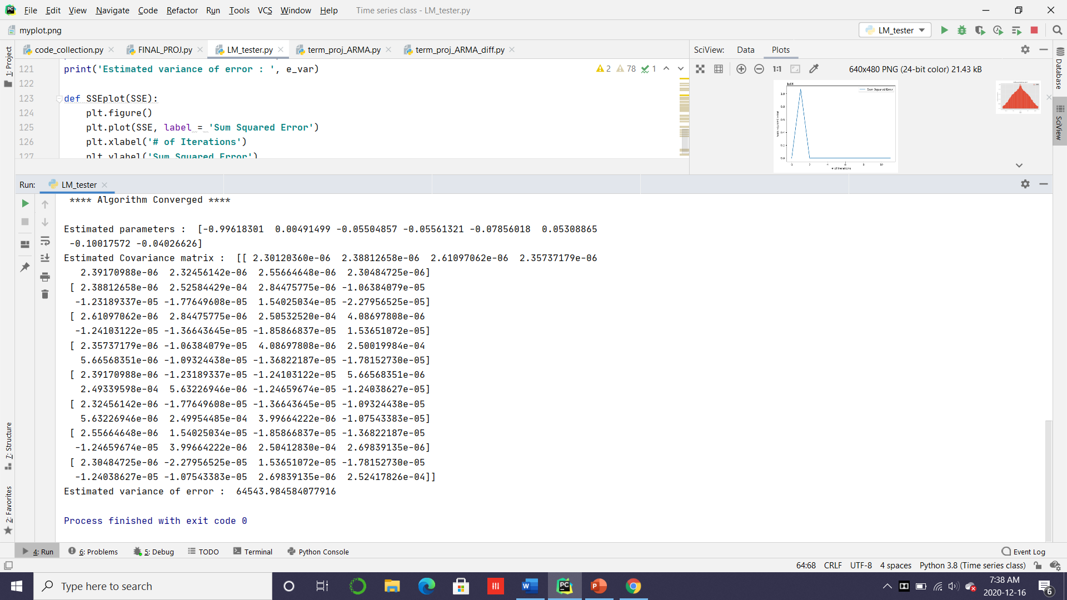
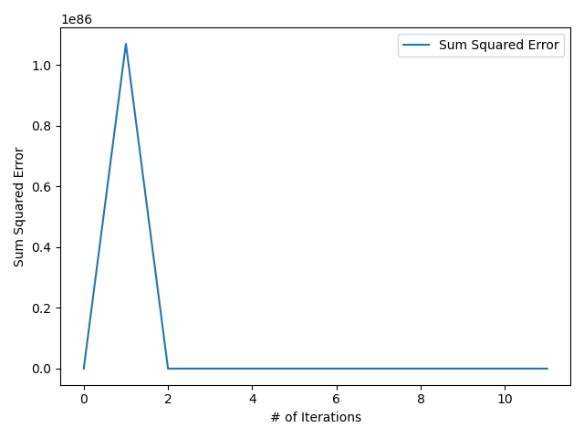
LM Algo

Slide 31
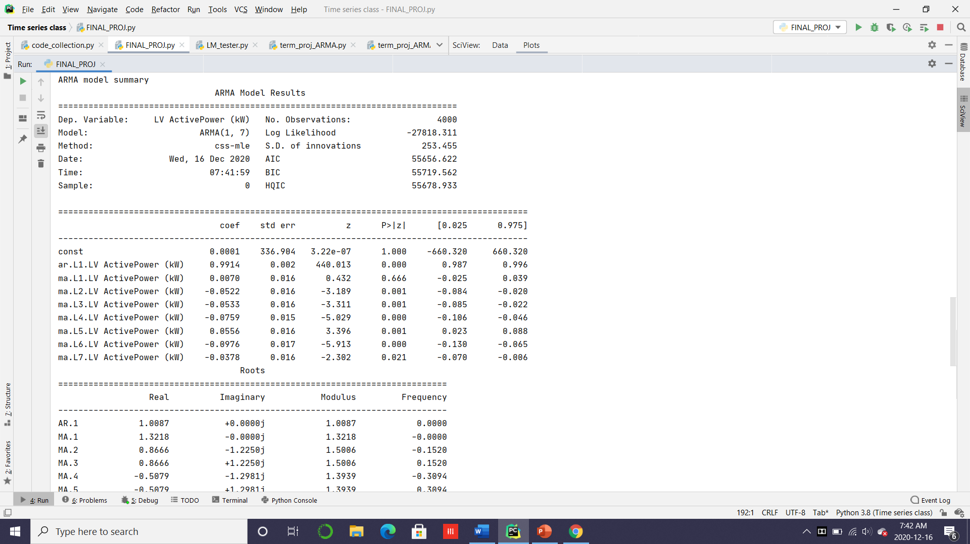
ARMA Model

Slide 32
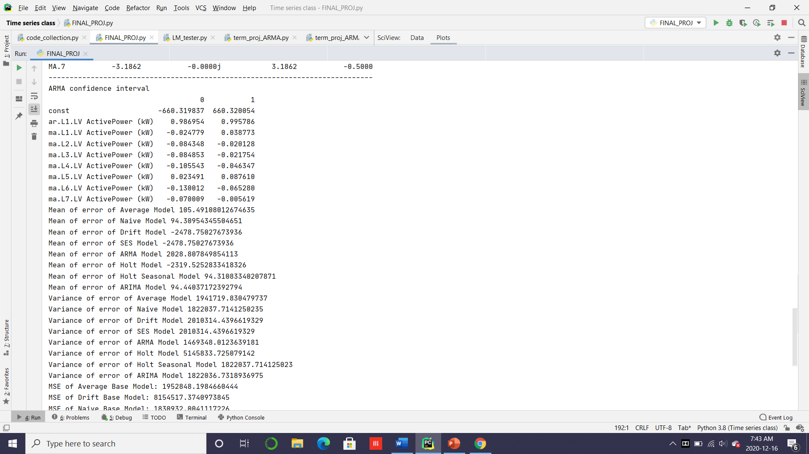
ARMA Confidence Interval

Slide 33
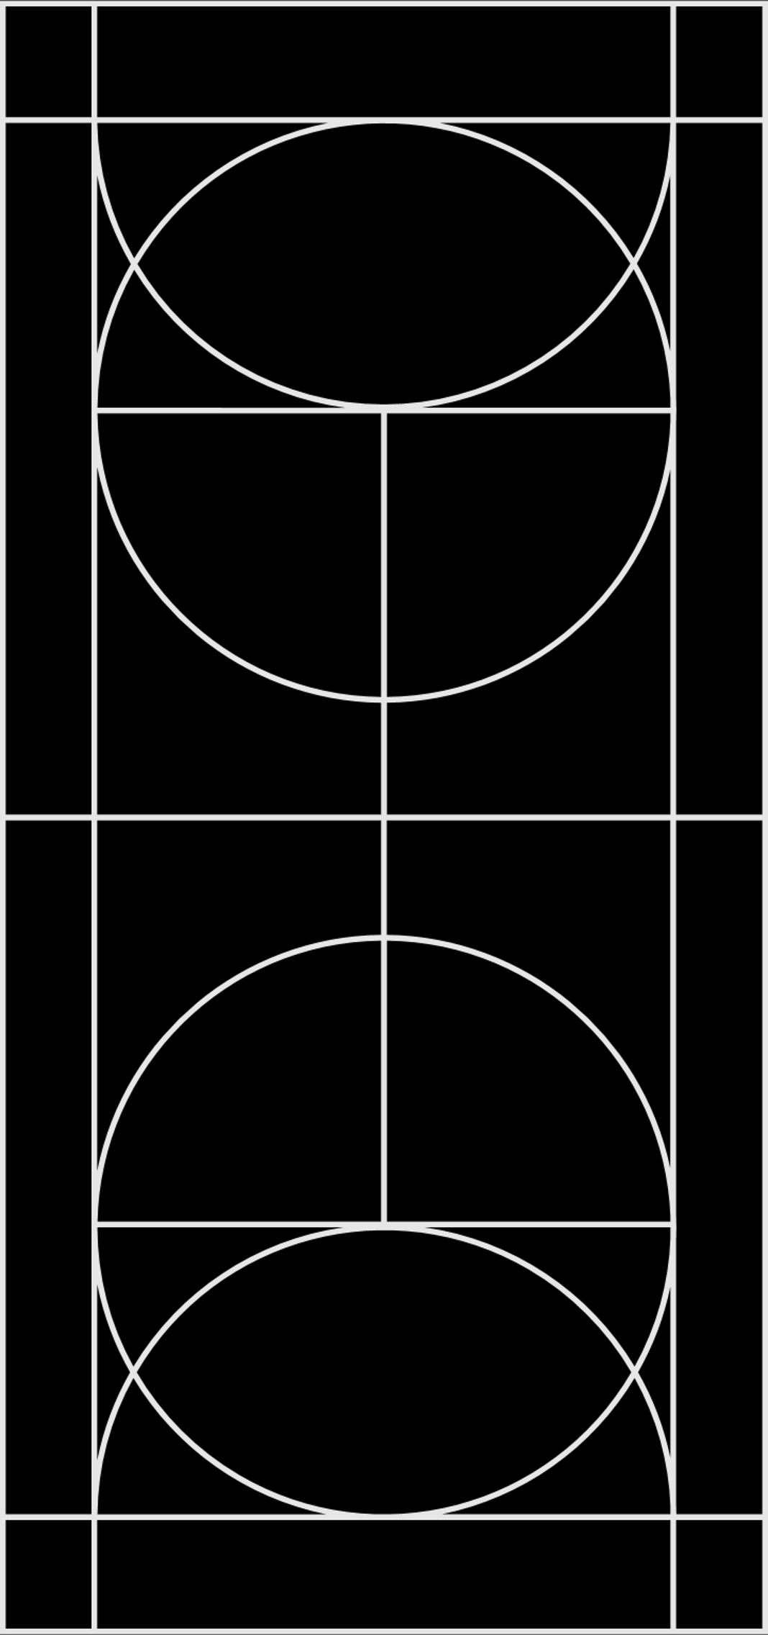
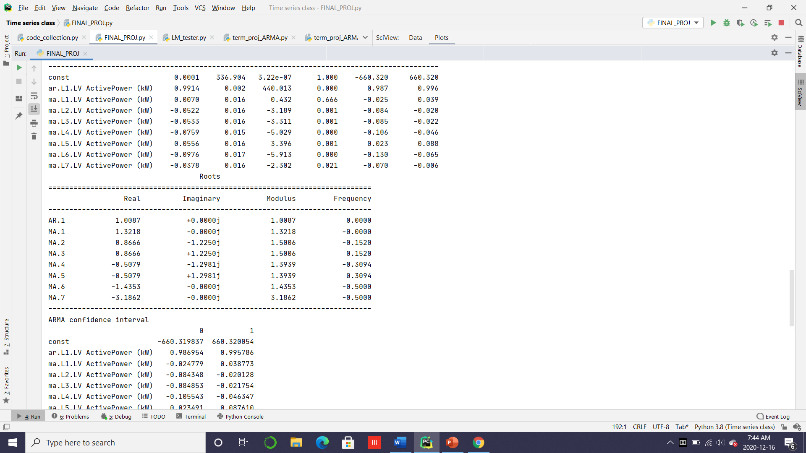
Zero Pole cancellation

Slide 34
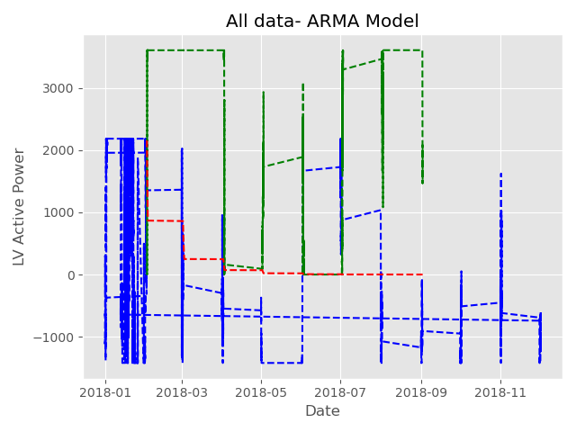
ARMA Model
Mean of error of ARMA Model 2028.807849854113
Variance of error of ARMA Model 1469348.0123639181
MSE of ARMA Model 5585409.303993587
RMSE of ARMA Model 2363.3470553419756

Slide 35
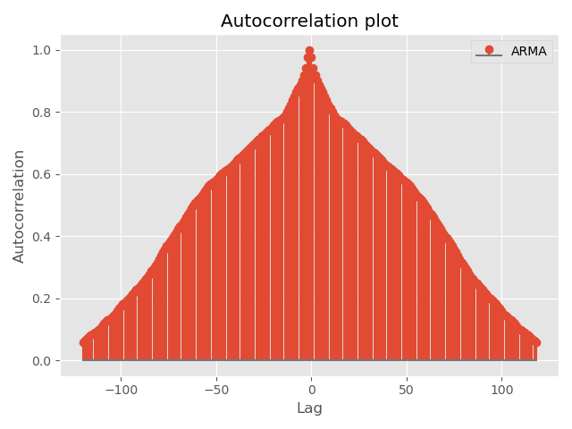
ACF of ARMA model

Slide 36
Comparing Models
Models​ | Mean​ | Variance​ | MSE​ | RMSE​
Average​ | 105.49108012674 ​ | 1941719.830479​ | 1952848.1984660​ | 1397.443450900​
Naive​ | 94.30954345504​ | 1822037.714125​ | 8154517.3740973​ | 2855.6115586853​
Drift​ | -2478.7502767​ | 2010314.439661​ | 1830932.0041117​ | 1353.1193606299​
SES​ | -2478.75027673​ | 2010314.439661​ | 8154517.3740973​ | 2855.6115586853​
Holt-Winter​ | -2319.52528334​ | 5145833.725079​ | 10526031.265141​ | 3244.3845741744​
Holt Seasonal | 94.3108334020787 | 1822037.71412502 | 1830932.2474220176 | 1353.1194505371718
ARMA​ | 2046.7929003476927 | 1489423.4357671 | 5678784.612680916​ | 2383.020061325736
ARIMA​ | 94.41260437830951 | 1822037.0278738 | 1830950.7677393428 | 1353.126294083203
Q value Average Model 81.99712787277191
Q value Naive Model 88.92135966850353
Q value Drift Model 89.9517026952922
Q value SES Model 89.9517026952922
Q value Holt Model 138.8496438805654
Q value Holt Seasonal Model 88.92135966850353
Q value ARMA Model 70.46428204524204
Q value ARIMA Model 88.92138294937108

Slide 37
Forecast

Slide 38
Summary
The dataset has a strong Trend
Best model is the Multiple Linear Regression
ARMA perform a lot better than other models
Using more data can help increase the accuracy of the forecast

Slide 39
Thank you

